Slide 1
Unit 1
POSITIVE ATTITUDE
Approaching every day with enthusiasm, confidence and a positive outlook

Slide 2
Positive Attitude
Unit 1 Lesson Plans
Student Definition
Quote Exercise “Whether you think you can…”
Ethical Dilemma – Character
Lecture: Introduction of class, format and expectations
Scenes & questions from Cinderella Man
Role Model Chapters – Mattie Stepanek & Pete Frates
Basic Skill – Business Handshake & Body Language
Online Blog – https://characterandleadership.com/category/blog/
Leadership Exercise – Ball Sharing
Leadership Principle – Character First, Leadership Second
Writing Assignment: Attitude, Respect & Expectations
Complete WWW video assignment on Positive Attitude

Slide 3
Positive Attitude
“Whether you think you can, or you think you can’t – you’re right.”
-Henry Ford

Slide 4
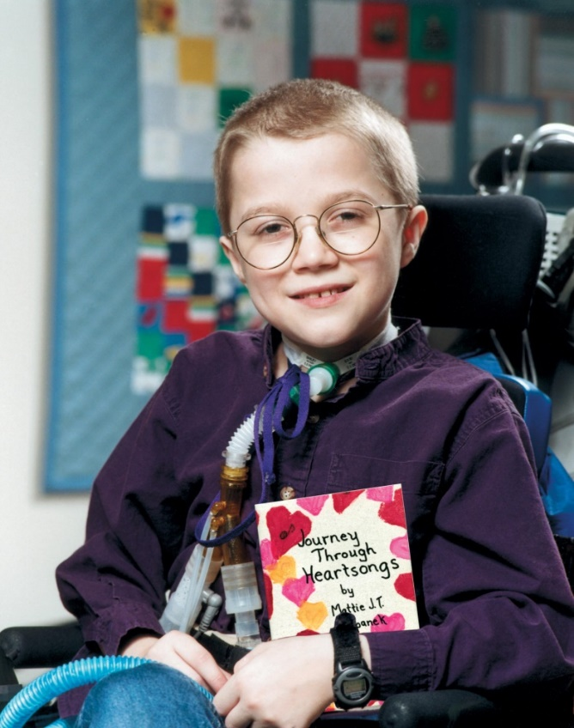
Positive Attitude
MATTIE STEPANEK
“The disease is a curse at first sight, but I wouldn’t be me without it. I haven’t given up. I don’t sit in the corner and cry about my life. I thank God for life. I make the fullest of it.”

Slide 5
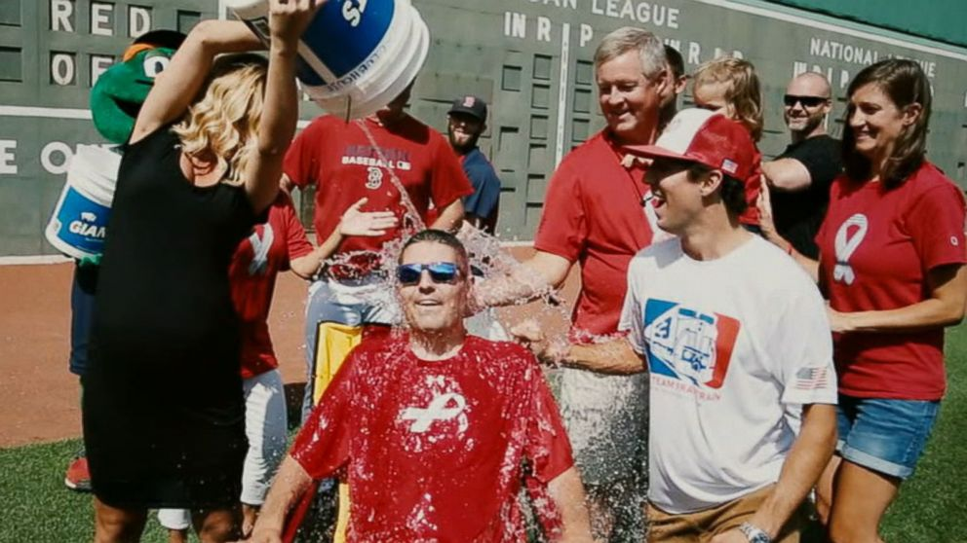
Positive Attitude
Pete Frates
“I’m going to change the face of this unacceptable situation of ALS. We’re going to move the needle and raise money to fight.”

