Slide 1
Unit 10
EMPATHY
Trying to understand another person’s experience; to put yourself in their shoes

Slide 2
Empathy
Unit 10 Lesson Plans
  Student Definition - Empathy
  Quote Exercise – “Conversation means…”
  Ethical Dilemma – Empathy & Disabilities
  Lecture: Improving Communication Skills
  Scenes & questions from The Blind Side
  Role Model Chapter – Helen Keller & Elena Delle Donne
  Basic Skill – The Blind Fold Exercise
  Online Blog characterandleadership.com/category/blog/
  Leadership Principle #10 – Leadership Styles
  Leadership Exercise – Back to Back Drawing
  Writing Assignment: Historic Interview
  WWW Video Assignment

Slide 3
Empathy
“Conversation means being able to disagree and still continue the discussion.”
-Dwight MacDonald

Slide 4
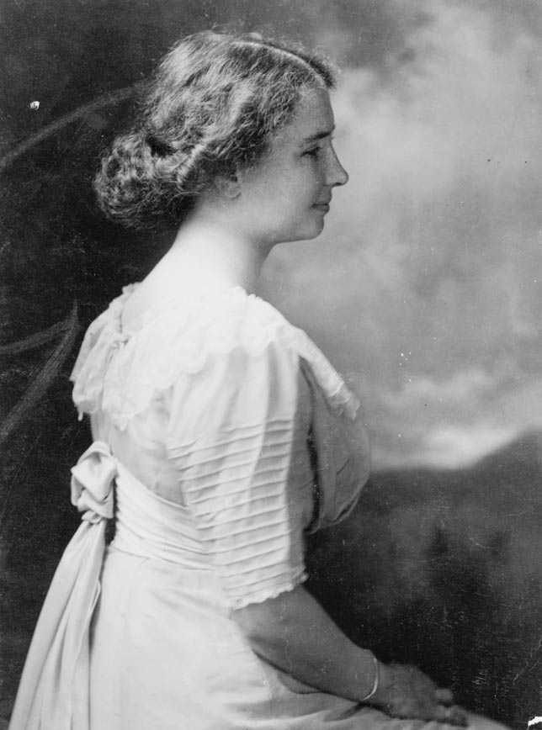
Empathy
HELEN KELLER
“The most pathetic person in the world is someone who has sight but has no vision.”

Slide 5
Empathy
Elena Delle Donne
“You gotta be you. It’s really difficult and exhausting trying to be somebody that everybody wants you to be.”

Slide 6

Empathy
HELEN KELLER
Helen Keller was born a happy, healthy child, but a fever left her blind and deaf at the age of 18 months.
Unable to reach Helen, her parents hired Annie Sullivan to live with the family and teach Helen to communicate.
With Annie Sullivan’s help, Helen Keller learned to read, write and communicate. Helen Keller went on to attend college and learned several languages.
As an adult Helen Keller helped others who were disadvantaged and faced obstacles.
She also stood up for causes she believed in such as a woman’s right to vote.

Slide 7
Empathy
Elena Delle Donne
Elena has an older sister named Lizzie, who is deaf, blind and has sever autism and cerebal palsy.
Elena has learned empathy through this relationship and has a strong bond with her sister.
Elena, by contrast, was named the #1 high school recruit in America her senior year.
She signed with UCONN, but only stayed 2 days. She missed her sister too much.
Elena has played over a decade in the WNBA.
She has won 1 WNBA championship and has
been awarded the WNBA MVP twice.

