Slide 1
Unit 11
COMPASSION
Showing kindness and giving support to fellow human beings

Slide 2
Compassion
Unit 11 Lesson Plans
  Student Definition - Compassion
  Quote Exercise “A good heart is better than all the…”
  Ethical Dilemma – Bullying Scenarios
  Lecture: Introduction of class, format and expectations
  Scenes & questions from Antwone Fisher
  Role Model Chapters – Oprah Winfrey & Manny Pacquiao
  Basic Skill –Bullying Role Plays
  Online Blog characterandleadership.com/category/blog/
  Leadership Principle – Leader with Intuition
  Leadership Exercise – Switch Sides If…
  Writing Assignment: Bullying & Cyber-Bulling in school
  WWW Video Assignment on Compassion

Slide 3
Compassion
“Strong people stand up for themselves, but the strongest people stand up for others.
-Unknown Author

Slide 4
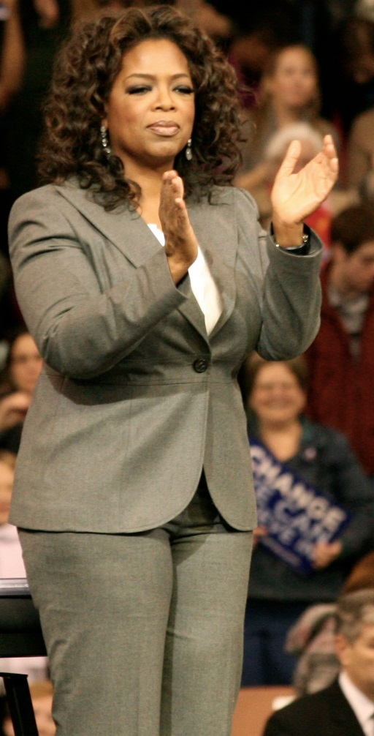
Compassion
OPRAH WINFREY
“I will continue to use my voice and my life as a catalyst for change, inspiring and encouraging people to help make a difference in the lives of others.”

Slide 5
Compassion
Manny Pacquiao
“I have achieved my dreams in boxing. What I want to achieve more is public service. I want to be a champion there.”

Slide 6
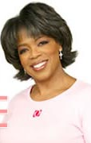
Compassion
OPRAH WINFREY
Oprah Winfrey was born in Mississippi in 1954.
Even though she was born poor and faced her share of obstacles, she is currently the 6th wealthiest woman in the world and is valued at over $1 billion dollars.
Oprah Winfrey’s company, Harpo, owns the rights to the show, The Own TV Network and O Magazine.
In 1997 she started Oprah’s Angel Network to inspire others to donate and over $20 million has been collected and donated to date.
Oprah Winfrey was honored with the Bob Hope Humanitarian Award in 2002 for all of her charitable work.

Slide 7
Compassion
Manny Pacquiao
Manny was born in the war-torn Philippines in 1978 and grew up in a grass hut.
When he turned 12, he began boxing to earn money.
At the age of 16, Manny lied about his age and turned professional.
At the age of 22, he became a world champion. He defeated 22 world champions and won titles from 105 to 144 lbs., holding world titles in 8 different weight divisions.
Manny became a senator and ran for president
of the Philippines in order to give back
to his people.

