Slide 1
Unit 12
TOLERANCE
To understand and embrace people from different backgrounds and those who have different beliefs; not judging others based
on superficial qualities

Slide 2
Tolerance
Unit 12 Lesson Plans
  Student Definition - Tolerance
  Quote Exercise – “I have a dream that…”
  Ethical Dilemma – What if your best friend was gay
  Lecture: Cultural Competence
  Scenes & questions from Remember the Titans
  Role Model Chapter – Arthur Ashe & Billie Jean King
  Basic Skill – Performing Random Acts of Kindness
  Online Blog characterandleadership.com/category/blog/
  Principle #12 – Leadership is Relational
  Writing Assignment: Personal Views on Discrimination
  Contribute to WWW “Tolerance” assignment

Slide 3
Tolerance
“I have a dream that my four little children will one day live in a nation where they will not be judged by the color of their skin, but by the content of their character.”
-Martin Luther King, Jr.

Slide 4
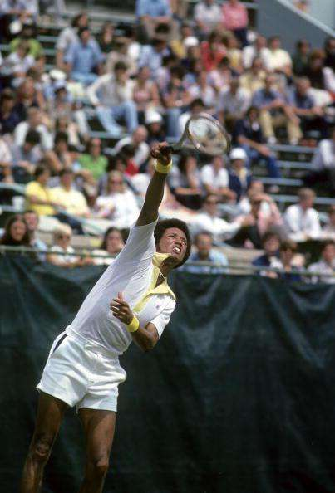
Tolerance
ARTHUR ASHE
“In the end, I am not black or white, nor even for the United States of America, but for the whole of humanity… My humanity comes first.”

Slide 5
Tolerance
Billie Jean King
“It’s just really important that we start celebrating
our differences. Let’s start tolerating first, but
then we need to celebrate our differences.”

Slide 6
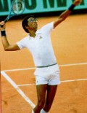
Tolerance
ARTHUR ASHE
Arthur Ashe was a professional tennis player in the 1960s and 1970s.
He grew up in Richmond, Virginia and due to segregation, was not permitted to play tennis with white children.
Arthur Ashe became the first black male to win the U.S. Open.
Arthur Ashe became infected with the AIDS virus during a blood transfusion in 1983.
He gave this new disease a face and helped educate the public before his death in 1993

Slide 7
Tolerance
Billie Jean King
Billie Jean was ranked #1 at seven different times in her career, winning 20 Wimbledon Titles, 13 US Open Titles, 4 French and 2 Australian Open Titles.
Billie Jean played Bobby Riggs in the Battle of the Sexes Match on September 20, 1973
She is the founder of the Women’s Tennis Association and she is mainly responsible for getting the women equal pay as the men in tennis.
Billie Jean is still consulted when women’s sports groups are attempting to get equal pay.

