Slide 1
Unit 13
SERVICE
A sense of obligation to give something back to community and society

Slide 2
Sacrifice
Unit 13 Lesson Plans
Student Definition - Service
Quote Exercise – “A life is not important except…”
Ethical Dilemma – Donating to Charities
Lecture: No lecture
Scenes & questions from Pay It Forward
Role Model Chapter – Pat Tillman & Nile Kinnick
Basic Skill – Perform Community Service
Online Blog characterandleadership.com/category/blog/
Principle #13 – Motivating Your Team to Do & Be Better
Leadership Exercise – Video Scavenger Hunt
Writing Assignment: Reflections of Community Service
WWW Video Assignment on Service

Slide 3
Sacrifice
“A life is not important except in the impact it has on others lives.”
-Jackie Robinson

Slide 4
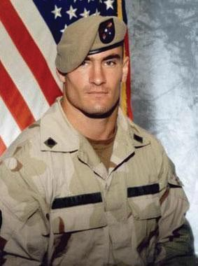
Sacrifice
PAT TILLMAN
I was dumbfounded by everything that was going on. In times like this, you stop and think how good we have it. I have always had a great deal of feeling for the flag, but you don’t realize how great of a life we have over here…”

Slide 5
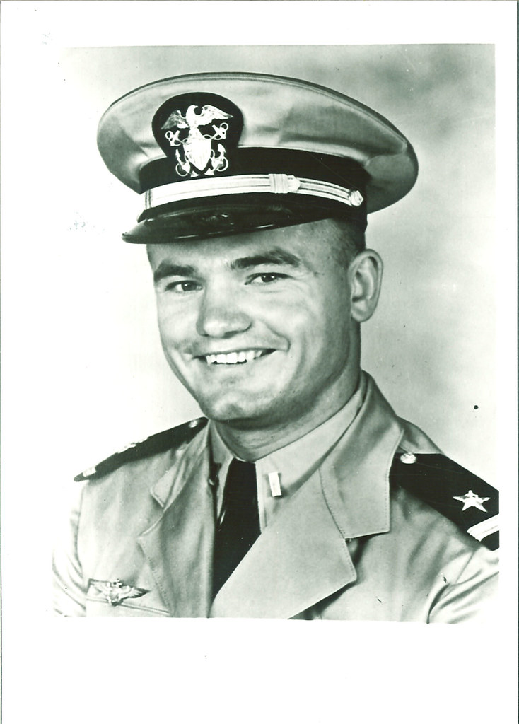
Sacrifice
Nile Kinnick
“Every man who I’ve admired in history has willingly and courageously served in his country’s armed forces in times of danger. It is not only a duty but an honor to follow their example the best I know how. ”

Slide 6
Sacrifice
PAT TILLMAN
Pat Tillman was a professional football player for the Arizona Cardinals.
After the September 11th attack, Pat joined the Army and became a member of the Rangers, an elite unit.
He left a $3.6 million pro football contract behind. “For the love of my brother. And for the love of my country,” was his explanation.
In April 2004, Pat Tillman made the ultimate Duty for his country when he was killed in Afghanistan.
Pat Tillman was a free spirit and lived a life of conviction.

Slide 7
Sacrifice
NILE KINNICK
At the University of Iowa, Nile played 402 of a possible 409 minutes as a senior, and was responsible for 107 of the 130 points his team scored.
He won the Heisman Trophy in 1939.
After he graduated, he joined the Navy to fight Hitler and the Nazi Regime.
He became a Navy pilot, flying an F4F Wildcat.
Nile died on June 2, 1943 when his plane had a severe oil leak. He couldn’t make it to shore and the flightdeck of the USS Lexington was full. He ditched in the ocean. 5 minutes later, he was dead.

