Slide 1
Unit 11
INITIATIVE
Taking action to achieve something or to solve a problem; a willingness to get things done and take responsibility.

Slide 2
Initiative
Unit 11 Lesson Plans
Student Definition - Initiative
Quote Exercise – “Chew Off More Than You Can Chew… then Begin Chewing”
Ethical Dilemma – 3 scenarios
Lecture: Defining Personal Branding
Scenes & questions from We Bought a Zoo
Role Model Chapter – Nate Boyer & Elon Musk
Basic Skill – Do’s and don’ts of social media
Online Blog characterandleadership.com/category/blog/
Leadership Principle #11 – Creating Energy Around You
Leadership Exercise – The Human Knot
Writing Assignment: 30-second Elevator Pitch
WWW Video Assignment

Slide 3
Initiative
“Bite off more than you can chew, then chew it.”
-Ella Williams

Slide 4
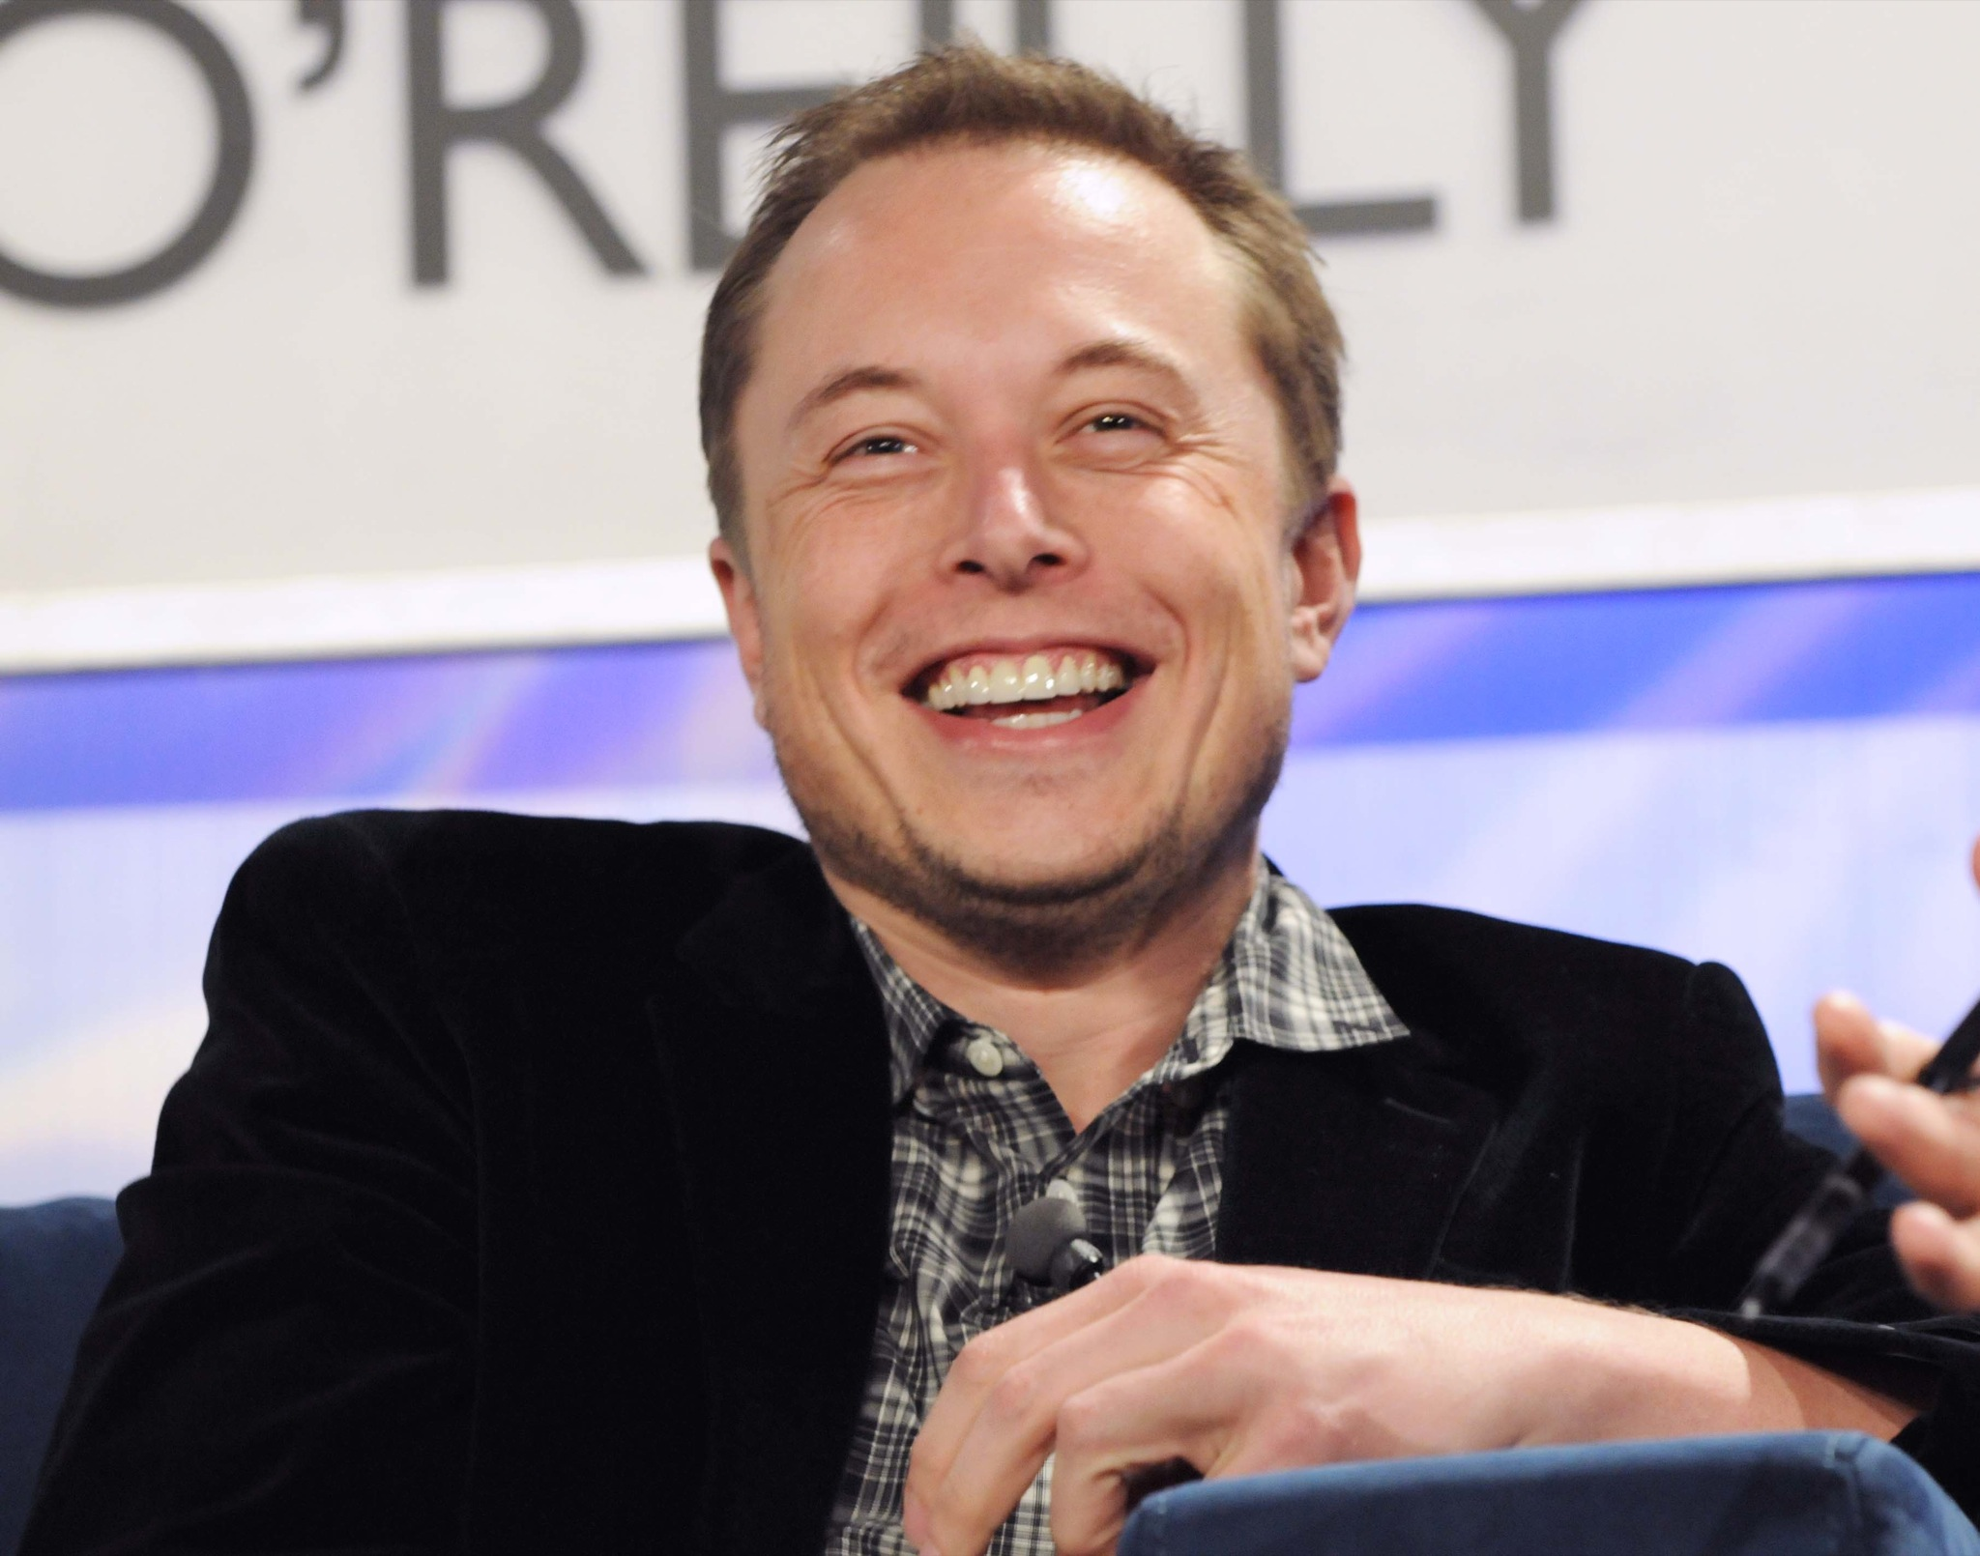
Initiative
Role Model Elon Musk
"I love humanity and I think we should fight for a good future for humanity. I think we should be optimistic about the future and we should fight to make the optimistic future happen."

Slide 5
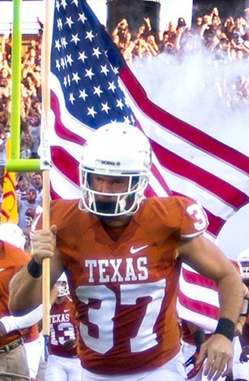
Initiative
Role Model - Nate Boyer
“A lot of people have these dreams, a lot of the time they’re just fleeting. The fact that I focus all of my energy into making them happen is why it happens.”

