Slide 1
Unit 14
LOYALTY
Demonstrating a strong commitment to people or ideals; staying true to your word

Slide 2
Loyalty
Unit 15 Lesson Plans
Student Definition – Loyalty
Quote Exercise – “You don’t earn loyalty…”
Ethical Dilemma – Tough Decisions About Marriage
Lecture: Making Marriage Last
Scenes & questions from A Walk To Remember
Role Model Chapters – Nancy Reagan & Team Hoyt
Basic Skill – Resume Writing
Leadership Principle #14 – Commitment to Learning & Self-Improvement
Leadership Exercise – Balance Ball
Writing Assignment: Loyalty in Relationships
WWW Video assignment on Loyalty

Slide 3
Loyalty
“You don't earn loyalty in a day. You earn loyalty day-by-day.”
-Jeffrey Gitomer

Slide 4
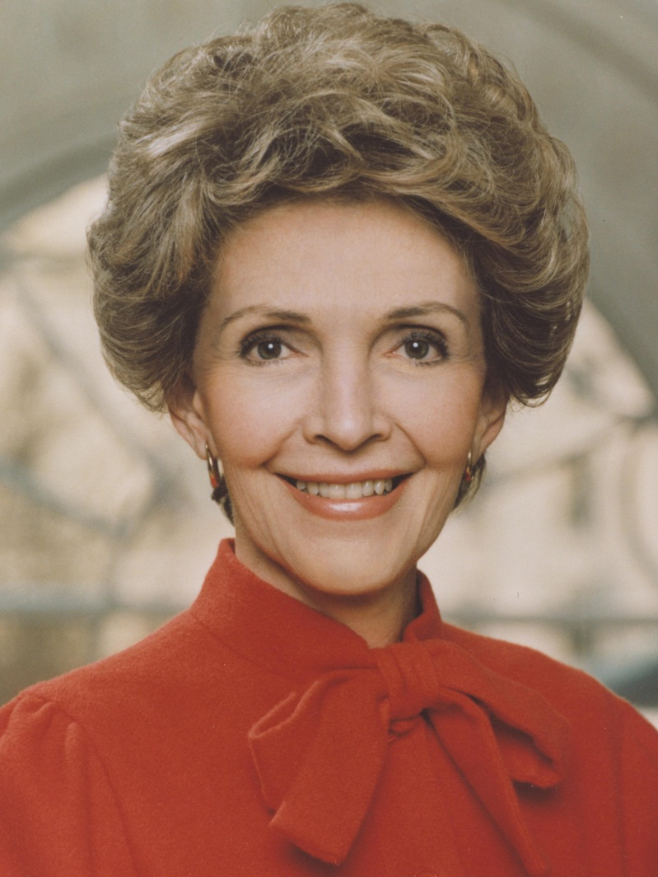
Loyalty
NANCY REAGAN
“I don’t ever remember once sitting down and mapping out a blueprint. It just became ‘we’ instead of ‘I’ very naturally and easily. And you live as you never have before, despite problems, separations and conflicts. I suppose you mainly have to be willing to want to give.”

Slide 5
Loyalty
Dick & Rick Hoyt
“It was a labor of love; a love between a man
and his son – a man who had patience equaled only
by his son’s courage.”

Slide 6
Loyalty
NANCY REAGAN
Nancy Reagan was married to Ronald Reagan for over 50 years.
Nancy and Ronald Reagan were incredibly committed to each other and he often wrote her love notes.
As the First Lady of both California and the United States, Nancy Reagan enjoyed her supporting role in the world of politics.
They faced many obstacles such as breast cancer, prostate cancer, an attempted assassination, and Alzheimer’s.
Nancy Reagan’s loyalty was most evident during Ronald Reagan’s 10 year battle with Alzheimer’s.

Slide 7
Loyalty
Dick & Rick Hoyt
Rick was born as a spastic quadriplegic with cerebral palsy.
The doctors told Dick and his wife to put Rick in an institution and forget about him.
Rick learned to communicate via the “Hope Machine” created by Tufts University.
Dick put Rick in a chair and pushed him in a race. Rick loved it.
Over the next 41 years, Team Hoyt competed in 1,130 races, including 72 marathons and 257 triathlons.

