Slide 1
Unit 18
CHARACTER
The centerpiece of all positive character traits. By improving on each trait, a person is improving their overall character.
Week 18

Slide 2
Character
Unit 18 Lesson Plans
Student Definition - Character
Quote Exercise
Ethical Dilemma – Character
Lecture: Weekly Summary of Class
Scenes & questions from the Emperor’s Club
Role Model Chapters – Vivien Thomas & Wayne Gretzky
Basic Skill – Saying Goodbye
Leadership Exercise – Question Ball
Writing Assignment: Take Home Final
Contribute to the WWW “character” assignment

Slide 3
Character
“Character cannot be developed in ease and quiet. Only through experience of trial and suffering can the soul be strengthened, vision cleared, ambition inspired, and success achieved.”
-Helen Keller

Slide 4
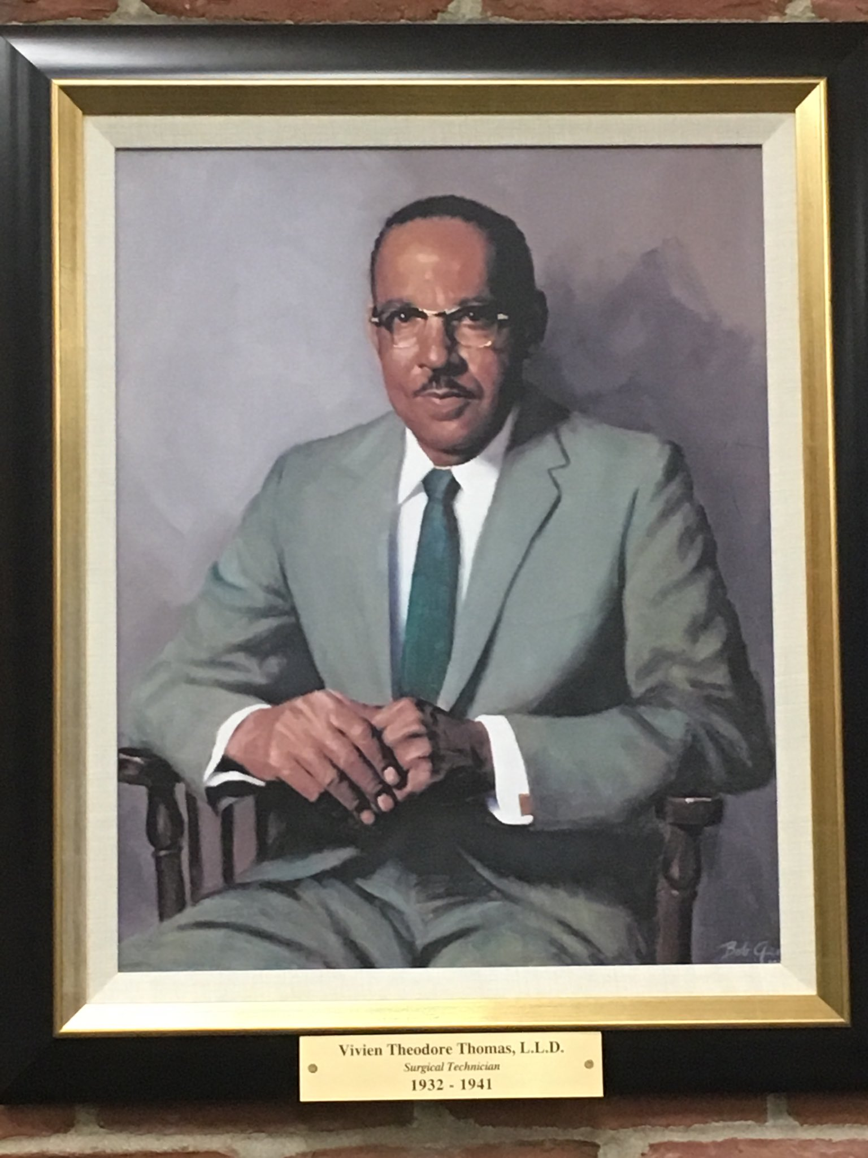
Leadership
Vivien Thomas
“I think the implications are extraordinary. Take a man like this, without much from anything, that impacts on inventions and also impacts on the nation’s premier heart surgeons. I look at him as a global person that rose above the conditions of his time.”

Slide 5
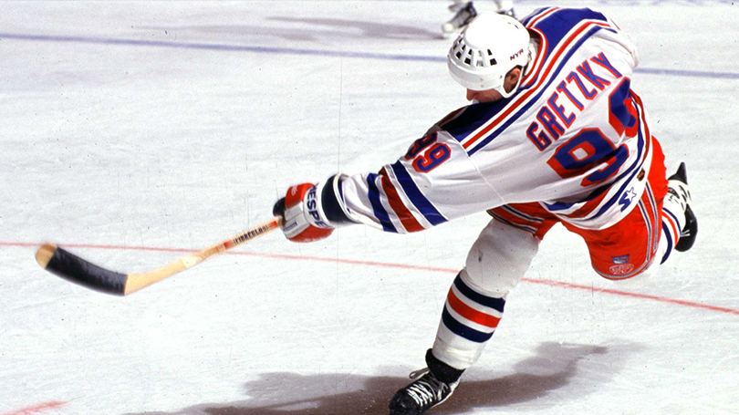
Leadership
Wayne Gretzky
“One of the things about being a celebrity is that you can help people that are less fortunate. That part of being Wayne Gretzky is most rewarding as far as I’m concerned.”

