Slide 1
Unit 2
PREPARATION
Doing All You Can Today to Ensure Successful Outcomes

Slide 2
Preparation
Unit 2 Lesson Plans
Student Definition & Quote Exercise
Ethical Dilemma – Epitaph Exercise
Lecture: Developing a Class Mission Statement
Scenes & questions from Stand & Deliver
Role Model Chapter – Captain “Sully” & Nelly Korda
Basic Skill – Calendar function on phone/tablet
Online Blog – Current Event
Principle #2 – Planning and Preparation are the keys
Leadership Exercise – Show and Tell
Writing Assignment: Personal Mission Statement & Goal Setting
Complete WWW Preparation assignment

Slide 3
Preparation
“Luck is what happens when preparation meets opportunity.”
-Seneca

Slide 4
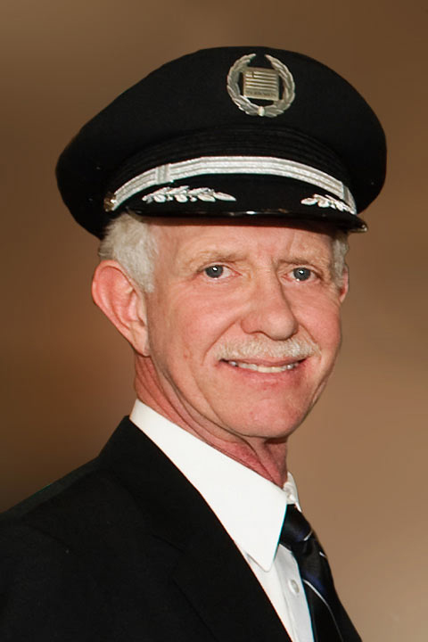
Preparation
Capt. Chesley “Sully” Sullenberger
“For 42 years, I’ve been making small, regular deposits in this bank of experience, education and training. On January 15th, the balance was sufficient so that I could make a very large withdrawal.”

Slide 5
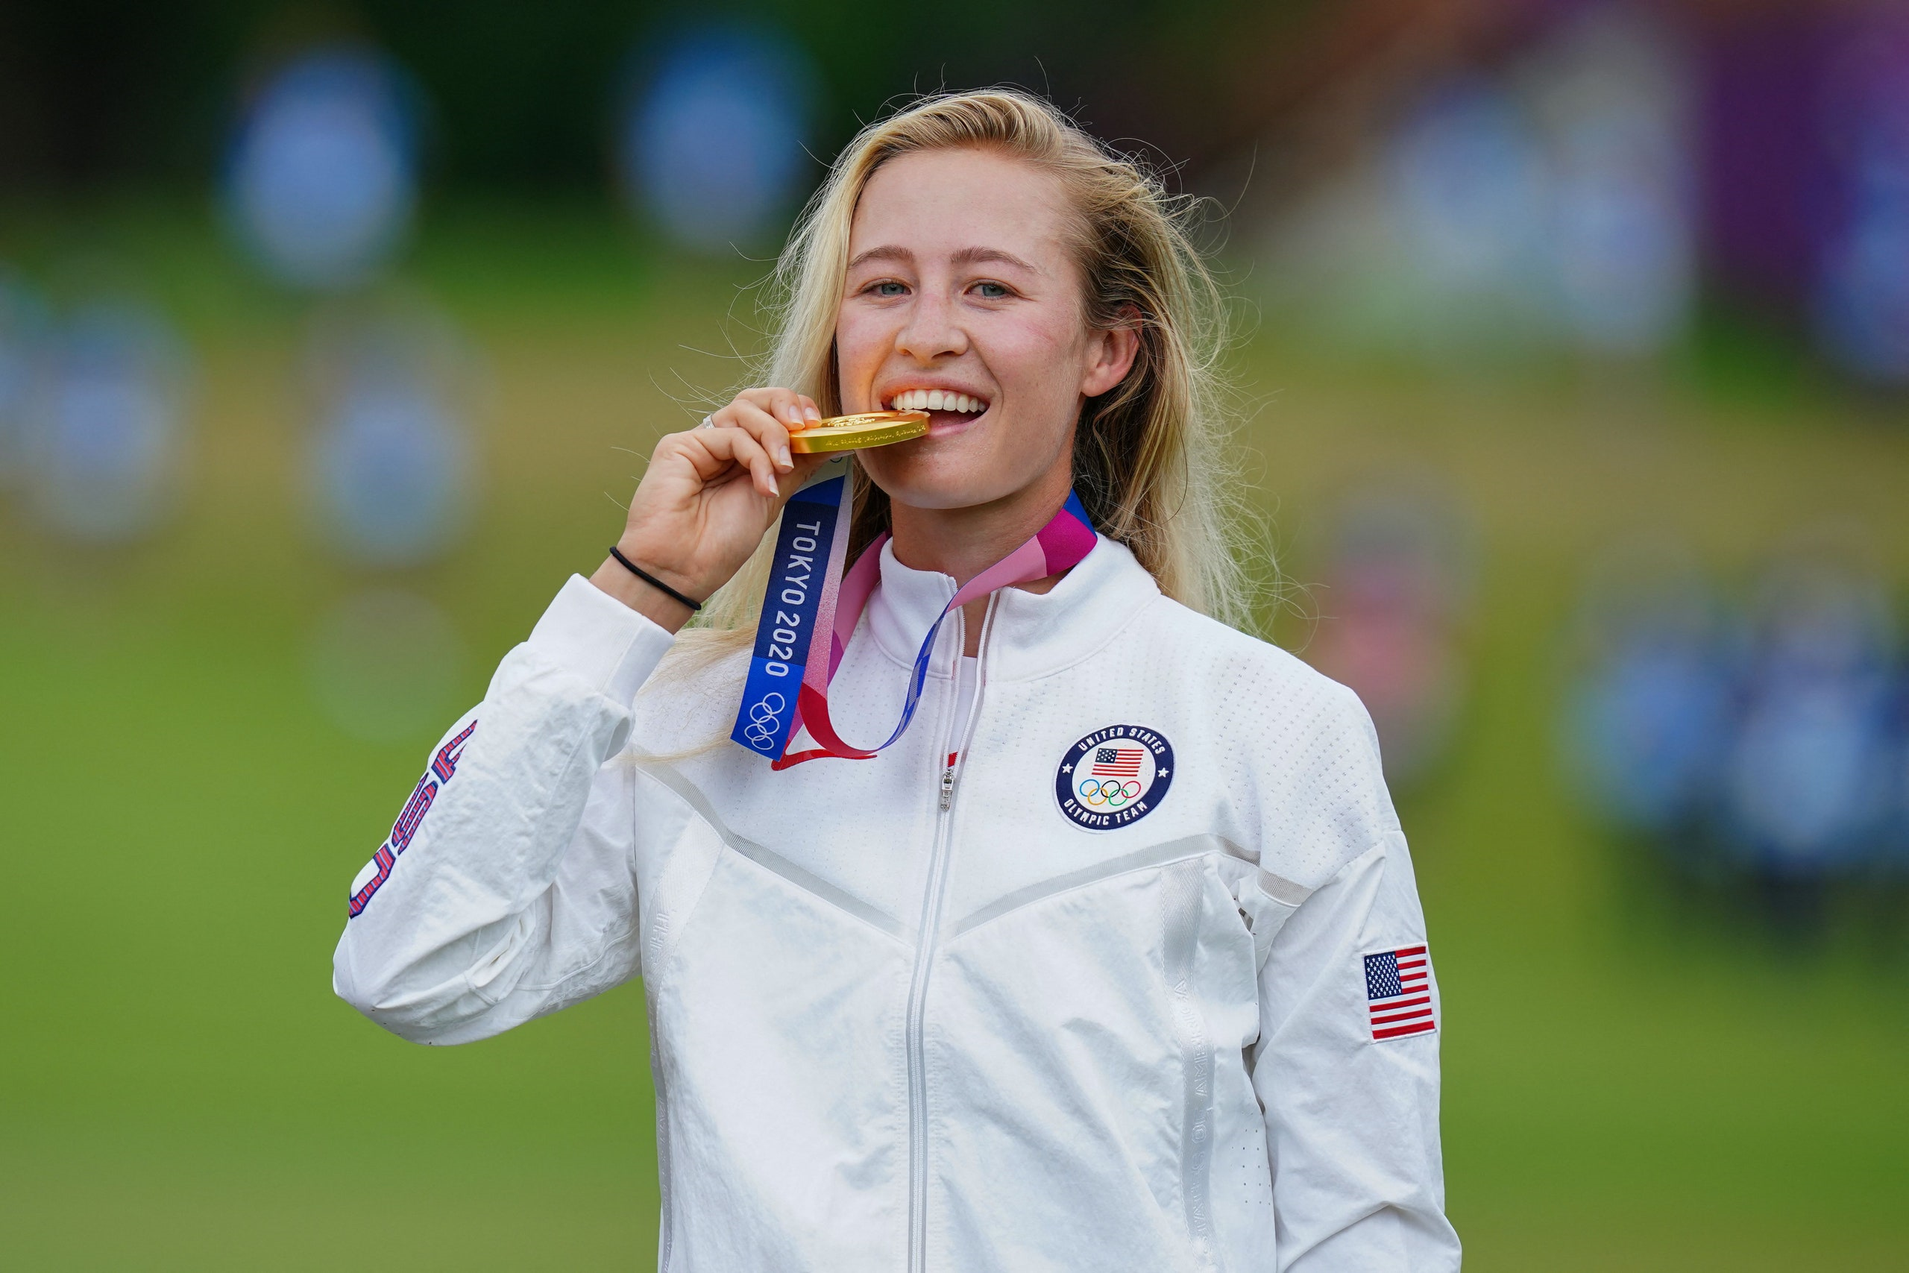
Preparation
Nelly Korda
“Every day’s a clean slate. You don’t know what’s going to happen, you don’t know what you’re going to shoot and the best you can do is go in with a good attitude and try your best.”

Slide 6
Preparation
Capt. Chesley “Sully” Sullenberger
Capt. Chesley “Sully” Sullenberger landed Flight 1549 in the Hudson River with all passengers/crew surviving.
At the age of five, he decided he wanted to be a pilot.
Before he could drive a car, Sullenberger obtained his pilot’s license.
He was a pilot for US Air for 29 years and is now retired. He travels the country teaching others how to respond in a crisis.
He is married and has two daughters.

