Slide 1
Unit 4
RESPECT
Being courteous to others through actions and words; to treat others the way we want to be treated

Slide 2
Respect
Unit 4 Lesson Plans
Student Definition – Respect
Quote Exercise
Ethical Dilemma – Rating your Respect Levels
Lecture: Instructor’s Personal Stories
Scenes & questions from Coach Carter
Role Model Chapters – Dwight Eisenhower & Pat Summitt
Basic Skill – Cell Phone Etiquette
Online Blog – characterandleadership.com/category/blog/
Leadership Principle – Respect is a Two-Way Street
Leadership Exercise – Water Carry
Writing Assignment: Respect of Self & Others
WWW Video Assignment on Respect

Slide 3
Respect
“Respect your efforts, respect yourself. Self-respect leads to self-discipline. When you have both firmly under your belt, that's real power.”
-Clint Eastwood

Slide 4
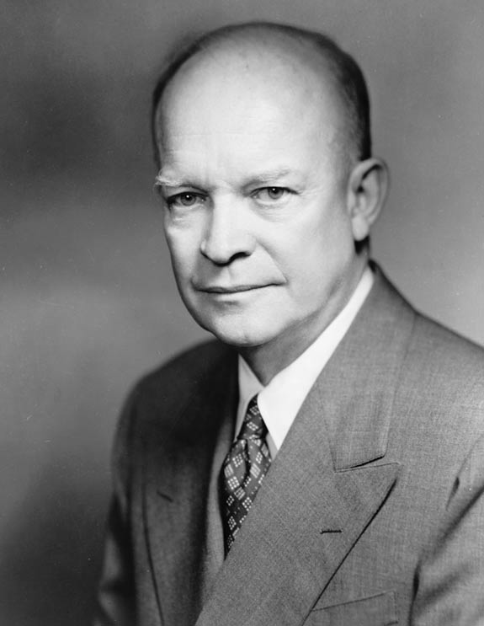
Respect
DWIGHT EISENHOWER
“My ambition in the Army was to make everybody I worked for regretful when I was ordered to other duty.”

Slide 5
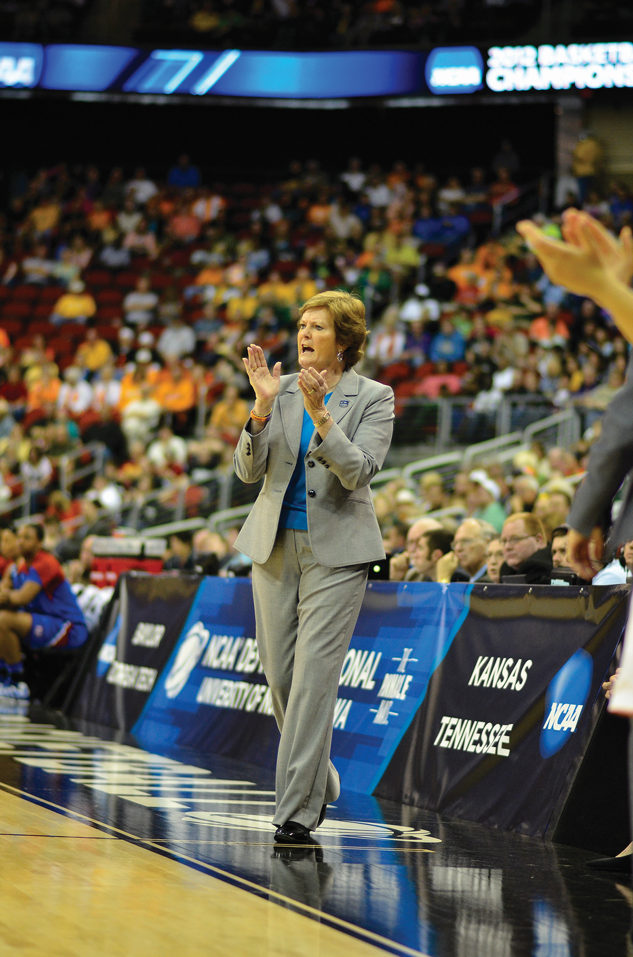
Respect
Pat Summitt
“I won 1,098 games, and eight national championships, and coached in four decades. But what I see are not the numbers. I see their faces.”

Slide 6
Respect
DWIGHT D. EISENHOWER
Dwight D. Eisenhower led one of the most famous battles of WWII – The D-Day Invasion.
Dwight D. Eisenhower rose from a colonel in the United States Army to a 5-star general in just two years.
He was a strong leader and his philosophy was, “In victory, spread the wealth and in defeat, accept full responsibility.”
Not only did he earn countless people’s respect, Dwight D. Eisenhower also gave respect.
Dwight D. Eisenhower was the 34th President of the United States.

Slide 7
Respect
Pat Summitt
Pat was one of 6 children, all living on a farm, milking cows, bailing hay and harvesting crops.
When Pat played high school basketball, women had to play 6 on 6. Anyone know why?
She played college basketball and began coaching just before Title IX.
In 1974, she became the head women’s basketball coach at the University of Tennessee.
As a coach, she won 1,098 games, won 8 National Championships and graduated 100% of her players.

