Slide 1
Unit 5
HONESTY
Telling the truth regardless of the circumstances or consequences

Slide 2
Honesty
Unit 5 Lesson Plans
Student Definition - Honesty
Quote Exercise – George Washington Quote
Ethical Dilemma – 3 Honesty Scenarios
Lecture: Establishing a Positive Reputation
Scenes & questions from Quiz Show
Role Model Chapters – Sherron Watkins & Bobby Jones
Basic Skill – Classroom Contract
Online Blog – characterandleadership.com/category/blog/
Leadership Principle – Knowing Your Strengths & Weaknesses
Leadership Exercise – Silent Line Up
Writing Assignment: Accepting Responsibility for Actions
WWW Video Assignment

Slide 3
Honesty
“I hope that I shall always possess firmness and virtue enough to maintain what I consider the best of all titles – the character of an honest person.”
-George Washington

Slide 4
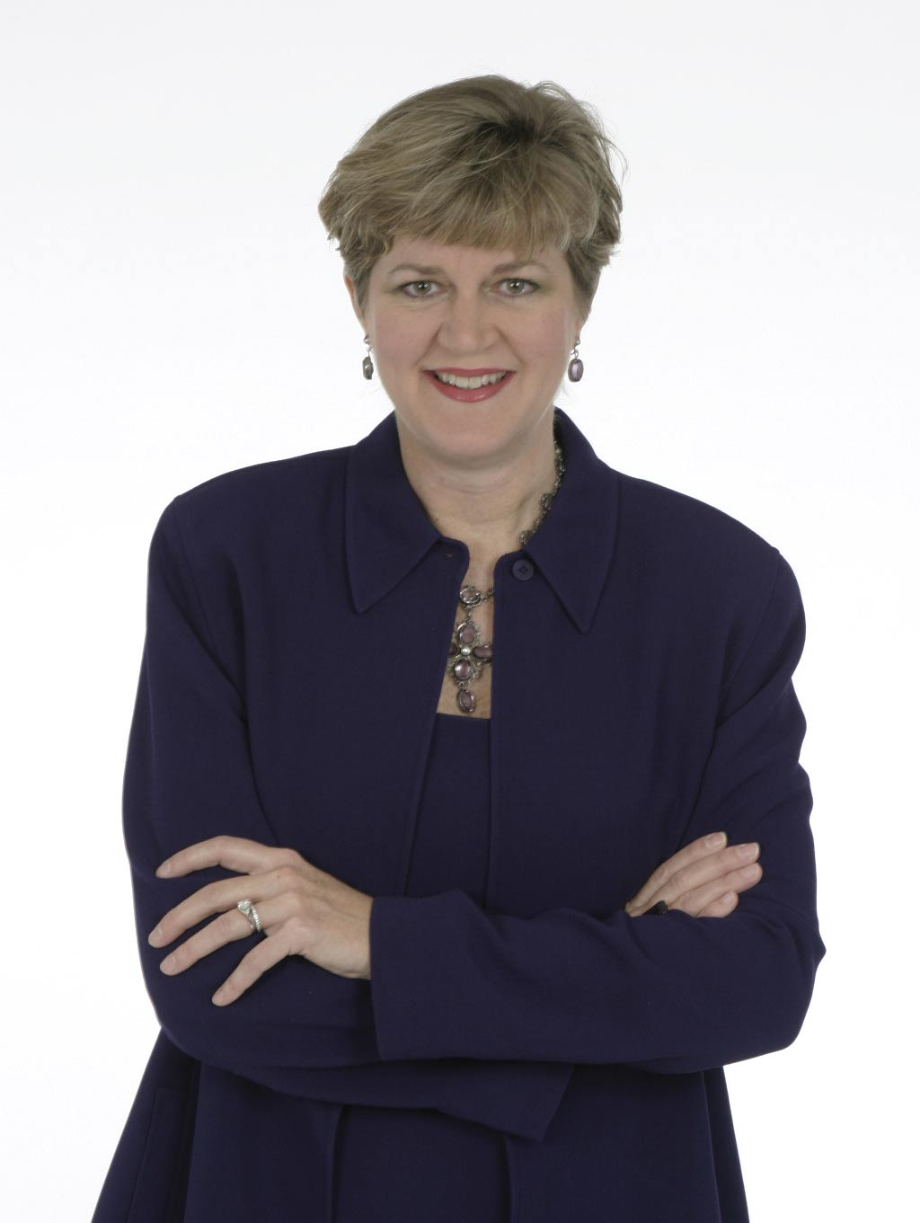
Honesty
SHERRON WATKINS
“There was a feeling that I had done the hardest thing in my life, but I had carried the torch and dropped it off.”

Slide 5
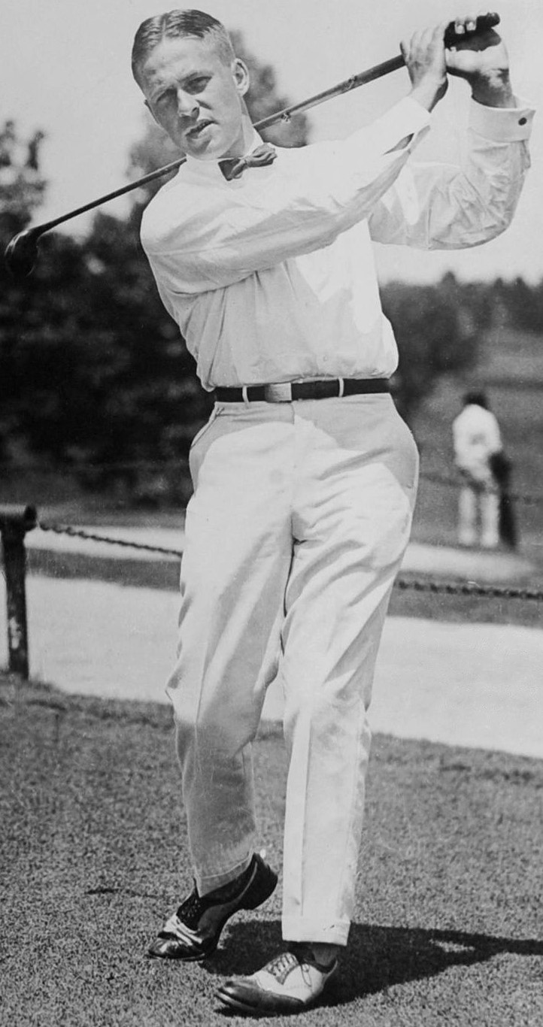
Honesty
BOBBY JONES
“There is only one way to play this game.”

Slide 6
Honesty
SHERRON WATKINS
Enron filed for the largest bankruptcy in history during 2001.
Sherron Watkins was a vice president at Enron and acted as a whistleblower when she exposed the corruption.
In 2002, she was named Person of the Year by Time magazine for her honesty and convictions.
Sherron Watkins testified before Congress about Enron’s wrong doings.
Major companies all over the world now pay up $25,000 to hear her speak.

Slide 7
Honesty
Bobby Jones
Bobby Jones is most known for retaining his amateur status while winning 13 major championships.
He is the architect of Augusta National Golf Course, home of the Master’s Tournament.
He served as an attorney after graduating from Harvard to support his family.
He fought admirably in WWII while in his 40’s because he knew it was the right thing to do.
He called a penalty on himself during the US Open, which cost him the championship.

