Slide 1
Unit 8
APPRECIATION
Being thankful for what you have, instead of complaining about what you don’t

Slide 2
Appreciation
Unit 8 Lesson Plans
Student Definition - Appreciation
Quote Exercise – “If I have seen further than others…”
Ethical Dilemma – What is a role model?
Lecture: The Importance of a Role Model
Scenes & questions from Mr. Holland’s Opus
Role Model Chapter – Christopher Reeve & Najee Harris
Basic Skill – Opening Doors for Others
Online Blog characterandleadership.com/category/blog/
Principle #8 – Setting the Tone with Optimism & Passion
Leadership Exercise – Hula Hoop Ground Touch
Writing Assignment: Letter to a Role Model
WWW Video Assignment

Slide 3
Appreciation
Appreciation
“If I have seen further than others, it is by standing on the soldiers of giants.”
-Sir Isaac Newton

Slide 4
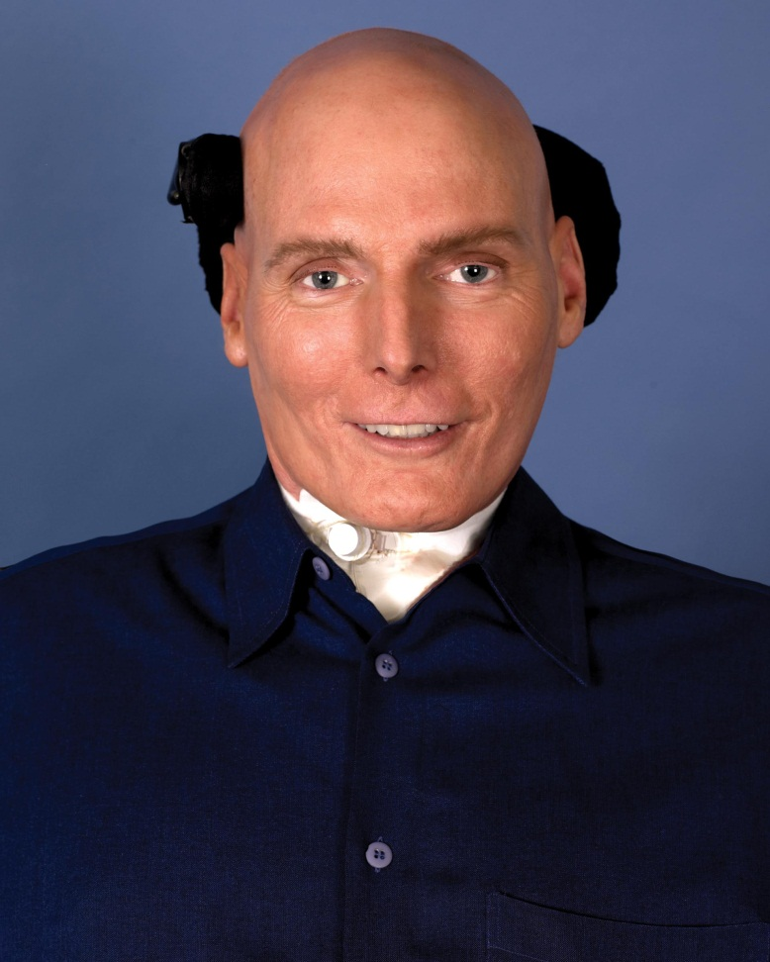
Appreciation
CHRISTOPHER REEVE
“To be able to feel just the lightest touch is really a gift. The fact is that even though your body doesn’t work the way it used to, the heart and the mind and the spirit are not diminished.”

Slide 5
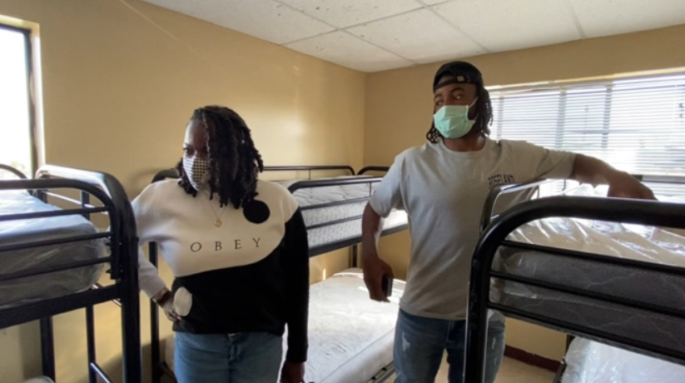
Appreciation
Najee Harris
“I just think about life, the business I’m in, how fake people are, how crazy society is, and then I think about how far I came, it’s really crazy. I’m so humbled to be here, cuz it was really really tough livin’ – to be in this position is just crazy.”

Slide 6
Appreciation
CHRISTOPHER REEVE
Christopher Reeve was famous for his role as Superman.
In 1995, Christopher Reeve was paralyzed from the neck down, becoming a quadriplegic.
He was ready to give up, but his wife and young son convinced him that he was still a husband and father even if he couldn’t use his arms and legs anymore.
He established the Christopher Reeve Foundation and worked hard to find a cure for paralysis.
Christopher Reeve died in 2004.

Slide 7
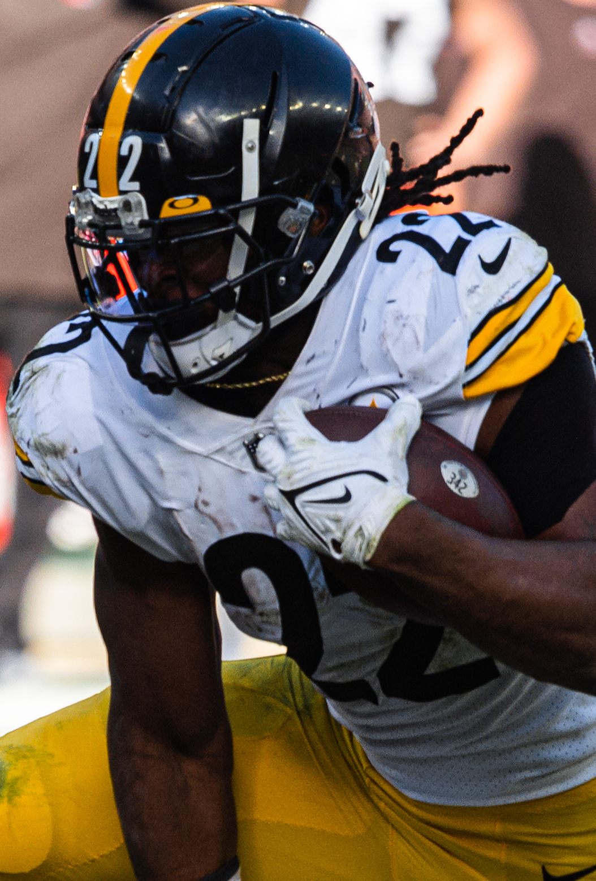
Appreciation
Najee Harris
Najee’s parents split up when he was very young.
Living with his mother and 4 siblings, they were often evicted because they couldn’t pay the bills.
Najee spent most of his young being homeless.
He discovered football in high school and became the nation’s #1 recruit.
On draft night, he held his draft party at one of the homeless shelters he frequented as a child.
Najee currently plays for the Pittsburg Steelers.

