Slide 1
Unit 9
COMPOSURE
Staying in control of one’s emotions in order to make good logical choices in difficult situations

Slide 2
Composure
Unit 9 Lesson Plans
Student Definition - Composure
Quote Exercise – “Anger is only one less short of…”
Ethical Dilemma – Anger Scenarios
Lecture: Taming the Temper
Scenes & questions from Apollo 13
Role Model Chapter – Martin Luther King, Jr. & Jackie Robinson
Basic Skill – Business Handshake & Body Language
Online Blog characterandleadership.com/category/blog/
Leadership Principle #9 – The Art of Decision Making
Leadership Exercise – Only Hands
Writing Assignment: Learning to Manage Your Anger
WWW Video Assignment on Composure

Slide 3
Composure
“Anger is only one letter short of danger.”
-Anonymous

Slide 4
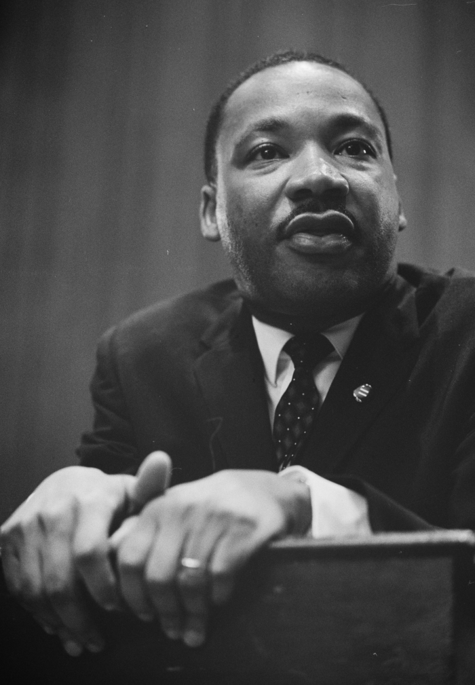
Composure
MARTIN LUTHER KING, JR.
“You must be willing to suffer the anger of the opponent, yet not return anger. You must not become bitter. No matter how emotional your opponents are, you must be calm.”

Slide 5
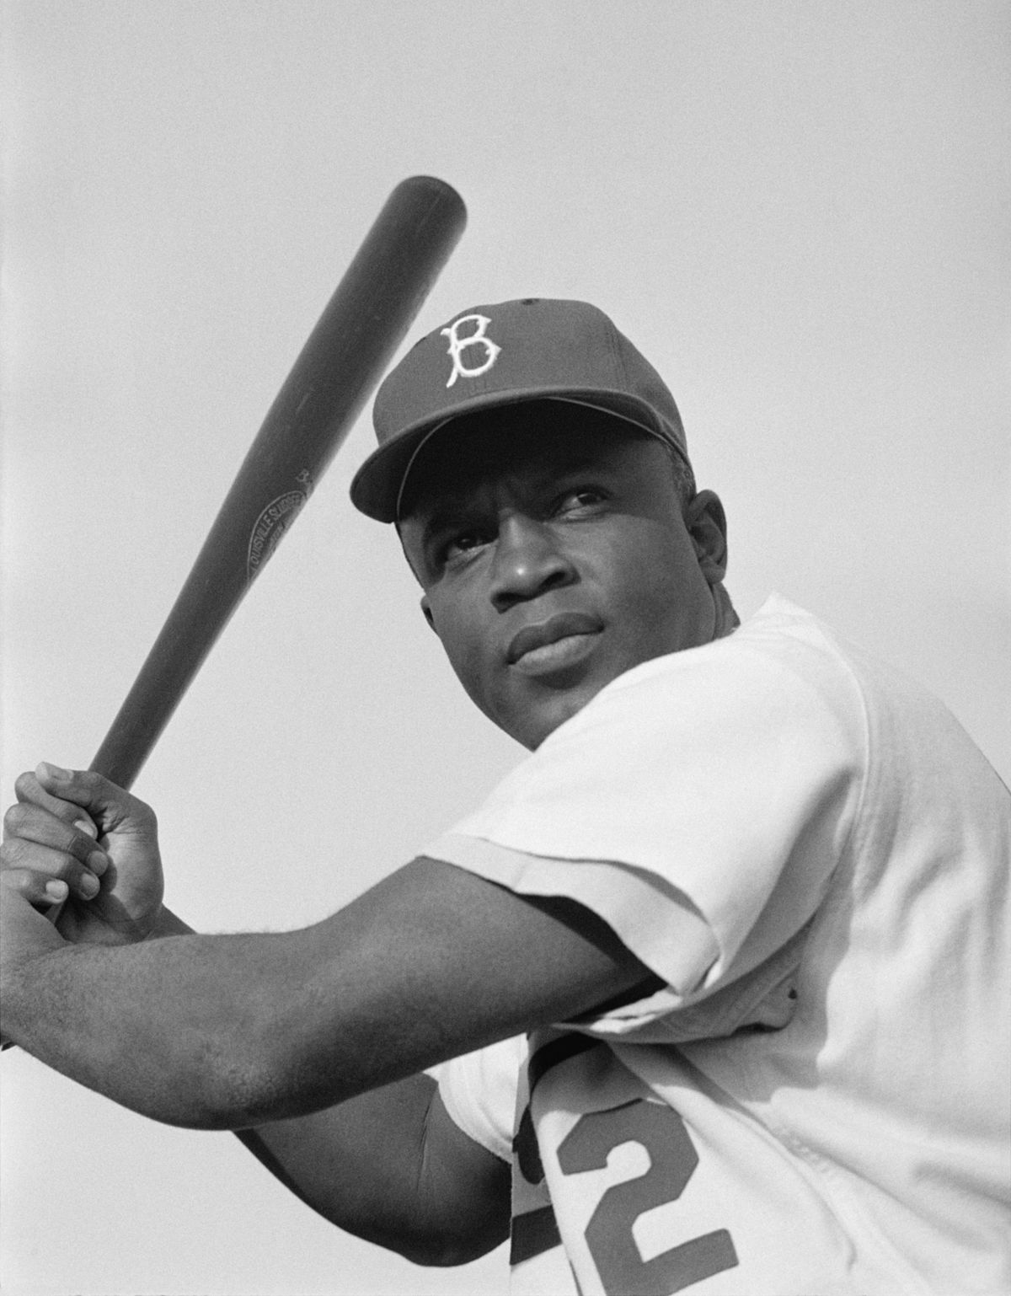
Composure
Jackie Robinson
“There is no doubt that the most important African American in our history was Martin Luther King, Jr. Similarly, there is no doubt that the second most important, and not second by much, was Jackie Robinson.”

Slide 6
Composure
MARTIN LUTHER KING, JR.
Martin Luther King Jr. was the voice of the Civil Rights Movement.
As a young boy, he learned from his father’s ability to confront racism with dignity and self-control.
Martin Luther King, Jr. was ordained a minister at the age of 18 and graduated from Morehouse College at 19.
He led the historic bus boycott in response to Rosa Parks being asked to give up her seat to a white person.
In August of 1963, overlooking the National Mall in D.C., King gave his famous “I Have A Dream” speech.

Slide 7
Composure
MARTIN LUTHER KING, JR.
Jackie was a 4-sport athlete at UCLA. His least impressive sport was baseball.
Jackie served in the Army during WWII.
Jackie became the first black person to break the color barrier and play in Major League Baseball.
Jackie played for 10 years in the MLB – won 1 world series, was MVP once and was named to 6 All-Star teams.
They retired his number from all of baseball. The only time a player can wear #42 is on Jackie Robinson Day, when all players wear #42 to honor this man.

